Slide 1
Income Inequality and Poverty
© 2015 Cengage Learning. All Rights Reserved. May not be copied, scanned, or duplicated, in whole or in part, except for use as permitted in a license distributed with a certain product or service or otherwise on a password-protected website for classroom use.

Slide 2
The Measurement of Inequality
Questions of measurement:
  How much inequality is there in our society?
  How many people live in poverty?
  What problems arise in measuring the amount of inequality?
  How often do people move among income classes?
© 2015 Cengage Learning. All Rights Reserved. May not be copied, scanned, or duplicated, in whole or in part, except for use as permitted in a license distributed with a certain product or service or otherwise on a password-protected website for classroom use.

Slide 3
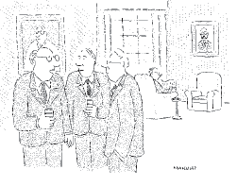
U.S. Income Inequality
Distribution of income
  Align families by income
  Divide all families into five equal groups
    Same number of families in each group
    Different incomes
      Bottom fifth: 4% of all income
      Top fifth: 47.8% of all income
“As far as I’m concerned, they can do what they want with the minimum wage, just as long as they keep their hands off the maximum wage.”
© 2015 Cengage Learning. All Rights Reserved. May not be copied, scanned, or duplicated, in whole or in part, except for use as permitted in a license distributed with a certain product or service or otherwise on a password-protected website for classroom use.

Slide 4
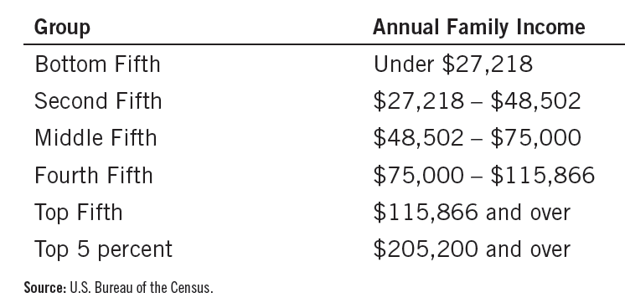
Table 1
The Distribution of Income in the United States: 2011
© 2015 Cengage Learning. All Rights Reserved. May not be copied, scanned, or duplicated, in whole or in part, except for use as permitted in a license distributed with a certain product or service or otherwise on a password-protected website for classroom use.

Slide 5
U.S. Income Inequality
Trends in income distribution
  1935-1970: more equal distribution
  1970-2011: more unequal distribution
Causes:
  Increase in international trade with low-wage countries
  Changes in technology
© 2015 Cengage Learning. All Rights Reserved. May not be copied, scanned, or duplicated, in whole or in part, except for use as permitted in a license distributed with a certain product or service or otherwise on a password-protected website for classroom use.

Slide 6
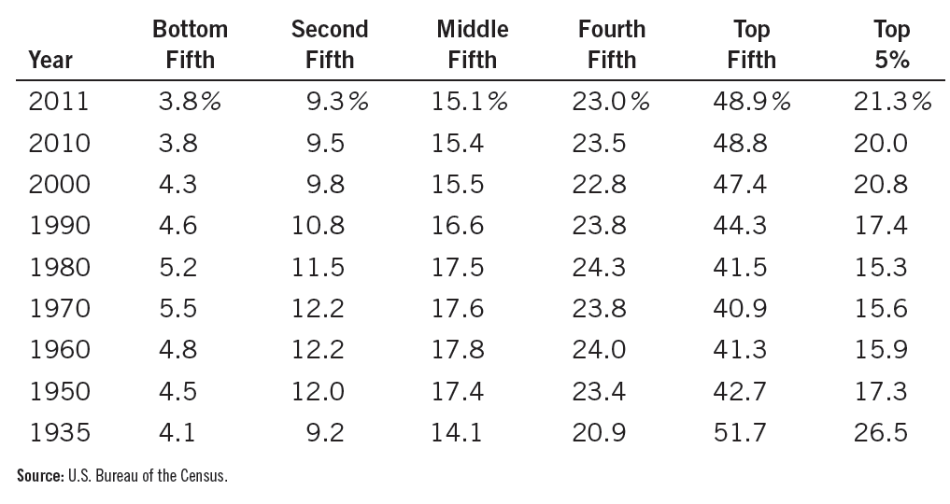
Table 2
Income Inequality in the United States
This table shows the percentage of total before-tax income received by families in each fifth of the income distribution and by those families in the top 5 percent.
© 2015 Cengage Learning. All Rights Reserved. May not be copied, scanned, or duplicated, in whole or in part, except for use as permitted in a license distributed with a certain product or service or otherwise on a password-protected website for classroom use.

Slide 7
Inequality Around the World
Inequality measure
  Ratio of the income received by the richest tenth of the population
  To the income of the poorest tenth
Degree of inequality
  Varies substantially around the world
© 2015 Cengage Learning. All Rights Reserved. May not be copied, scanned, or duplicated, in whole or in part, except for use as permitted in a license distributed with a certain product or service or otherwise on a password-protected website for classroom use.

Slide 8
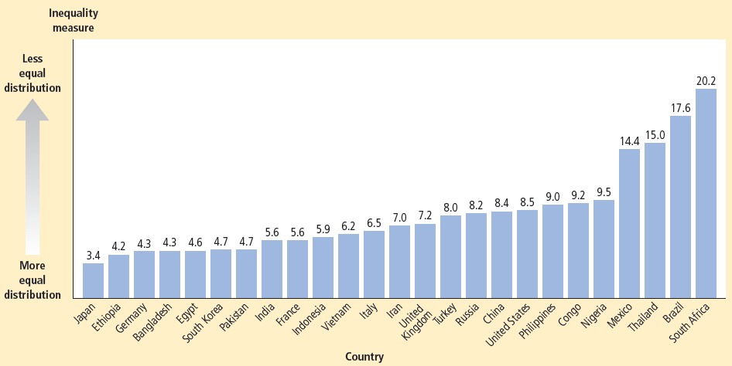
Figure 1
Inequality around the World
This figure shows a measure of inequality: the income (or expenditure) of the richest 20% of the population divided by the income (or expenditure) of the poorest 20%. Among these nations, Japan and Ethiopia have the most equal distribution of economic well-being, while South Africa and Brazil have the least equal.
© 2015 Cengage Learning. All Rights Reserved. May not be copied, scanned, or duplicated, in whole or in part, except for use as permitted in a license distributed with a certain product or service or otherwise on a password-protected website for classroom use.

Slide 9
The Poverty Rate
Poverty rate
  Percentage of the population
  Whose family income
    Falls below an absolute level (poverty line)
Poverty line
  An absolute level of income
    Set by the federal government for each family size
    Below which a family is deemed to be in poverty
© 2015 Cengage Learning. All Rights Reserved. May not be copied, scanned, or duplicated, in whole or in part, except for use as permitted in a license distributed with a certain product or service or otherwise on a password-protected website for classroom use.

Slide 10
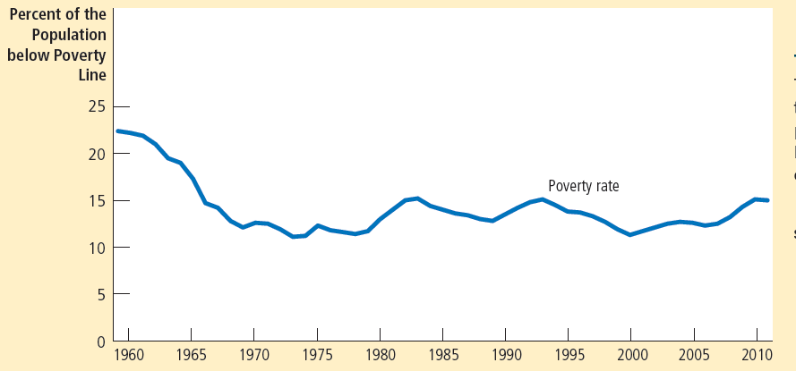

Figure 2
The Poverty Rate
The poverty rate shows the percentage of the population with incomes below an absolute level called the poverty line.
© 2015 Cengage Learning. All Rights Reserved. May not be copied, scanned, or duplicated, in whole or in part, except for use as permitted in a license distributed with a certain product or service or otherwise on a password-protected website for classroom use.

Slide 11
The Poverty Rate
2011, the U.S.
  Median family - income of $60,974
  Poverty line for a family of four: $23,021
  Poverty rate: 15%
Poverty rate
  1959: 22.4%
  1973: 11.1%, lowest to date
© 2015 Cengage Learning. All Rights Reserved. May not be copied, scanned, or duplicated, in whole or in part, except for use as permitted in a license distributed with a certain product or service or otherwise on a password-protected website for classroom use.

Slide 12
The Poverty Rate
Poverty - economic malady
  Affects all groups within the population
    Not with equal frequency
Poverty and race
  Blacks and Hispanics
    Three times more likely to live in poverty than whites
© 2015 Cengage Learning. All Rights Reserved. May not be copied, scanned, or duplicated, in whole or in part, except for use as permitted in a license distributed with a certain product or service or otherwise on a password-protected website for classroom use.

Slide 13
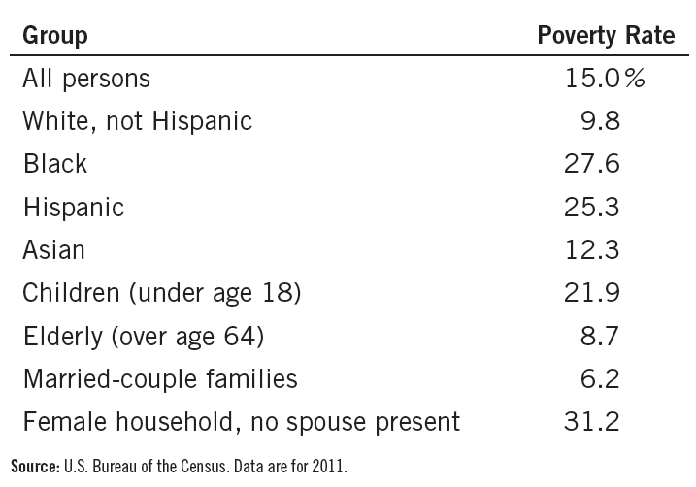
Table 3
Who Is Poor?
This table shows that the poverty rate varies greatly among different groups within the population.
© 2015 Cengage Learning. All Rights Reserved. May not be copied, scanned, or duplicated, in whole or in part, except for use as permitted in a license distributed with a certain product or service or otherwise on a password-protected website for classroom use.

Slide 14
The Poverty Rate
Poverty and age
  Children - more likely to be members of poor families
  The elderly - less likely to be poor
Poverty and family composition
  Families headed by a female adult and without a spouse present
    Five times as likely to live in poverty as a family headed by a married couple
© 2015 Cengage Learning. All Rights Reserved. May not be copied, scanned, or duplicated, in whole or in part, except for use as permitted in a license distributed with a certain product or service or otherwise on a password-protected website for classroom use.

Slide 15
Problems in Measuring Inequality
Data on income distribution & poverty rate
  Incomplete picture of inequality
  Household annual income
  Doesn’t account for in-kind transfers
    Transfers to the poor
    In the form of goods and services rather than cash
© 2015 Cengage Learning. All Rights Reserved. May not be copied, scanned, or duplicated, in whole or in part, except for use as permitted in a license distributed with a certain product or service or otherwise on a password-protected website for classroom use.

Slide 16
Problems in Measuring Inequality
Data on income distribution & poverty rate
  Normal life cycle pattern
    Causes inequality in the distribution of annual income
    May not represent true inequality in living standards
    Life cycle: regular pattern of income variation over a person’s life
© 2015 Cengage Learning. All Rights Reserved. May not be copied, scanned, or duplicated, in whole or in part, except for use as permitted in a license distributed with a certain product or service or otherwise on a password-protected website for classroom use.

Slide 17
Problems in Measuring Inequality
Data on income distribution & poverty rate
  Transitory vs. permanent income
    Transitory changes - need not affect standard of living
    A family’s ability to buy goods and services depends largely on its permanent income
    Permanent income: a person’s normal income
© 2015 Cengage Learning. All Rights Reserved. May not be copied, scanned, or duplicated, in whole or in part, except for use as permitted in a license distributed with a certain product or service or otherwise on a password-protected website for classroom use.

Slide 18
Alternative measures of inequality
Different measures of inequality lead to dramatically different results
Average annual income, 2006
  Poorest fifth of U.S. households = $9,974
  Richest fifth of U.S. households = $149,963
    About 15 times as much income as poorest fifth
© 2015 Cengage Learning. All Rights Reserved. May not be copied, scanned, or duplicated, in whole or in part, except for use as permitted in a license distributed with a certain product or service or otherwise on a password-protected website for classroom use.

Slide 19
Alternative measures of inequality
Account for progressive taxes
  Richest fifth
    About 14 times as much after-tax income as poorest fifth
Consumption
  Richest fifth
    3.9 times as much as the consumption of the poorest fifth
© 2015 Cengage Learning. All Rights Reserved. May not be copied, scanned, or duplicated, in whole or in part, except for use as permitted in a license distributed with a certain product or service or otherwise on a password-protected website for classroom use.

Slide 20
Alternative measures of inequality
Consumption
  Correct for differences in number of people in household
    Richest fifth - average of 3.1 people
    Poorest fifth - average of 1.7 people
  Consumption per person in the richest fifth
    Only 2.1 times as much as consumption per person in the poorest fifth
© 2015 Cengage Learning. All Rights Reserved. May not be copied, scanned, or duplicated, in whole or in part, except for use as permitted in a license distributed with a certain product or service or otherwise on a password-protected website for classroom use.

Slide 21
Economic Mobility
Economic mobility
  Movement of people among income classes
  Some reflects transitory variation in income
  Some reflects more persistent changes in income
  Many of those below the poverty line are there only temporarily
© 2015 Cengage Learning. All Rights Reserved. May not be copied, scanned, or duplicated, in whole or in part, except for use as permitted in a license distributed with a certain product or service or otherwise on a password-protected website for classroom use.

Slide 22
Economic Mobility
Persistence of economic success from generation to generation
  Above-average income carries over from parents to children
Millionaires
  Four of five millionaires made their money on their own
  One in five millionaires inherited their fortunes
© 2015 Cengage Learning. All Rights Reserved. May not be copied, scanned, or duplicated, in whole or in part, except for use as permitted in a license distributed with a certain product or service or otherwise on a password-protected website for classroom use.

Slide 23
Political Philosophy
What should the government do about economic inequality?
Political philosophies of redistributing income
  Utilitarianism
  Liberalism
  Libertarianism
© 2015 Cengage Learning. All Rights Reserved. May not be copied, scanned, or duplicated, in whole or in part, except for use as permitted in a license distributed with a certain product or service or otherwise on a password-protected website for classroom use.

Slide 24
Utilitarianism
Utilitarianism
  Political philosophy
  The government should choose policies to maximize the total utility of everyone in society
Utility
  Measure of happiness or satisfaction
© 2015 Cengage Learning. All Rights Reserved. May not be copied, scanned, or duplicated, in whole or in part, except for use as permitted in a license distributed with a certain product or service or otherwise on a password-protected website for classroom use.

Slide 25
Utilitarianism
Utilitarian case for redistributing income
  Based on diminishing marginal utility
  One extra dollar of income
    More utility to poor person than to rich person
  Government: redistribution of income
    From rich to poor to increase total utility
    Balance the gains from greater equality against the losses from distorted incentives
    Maximize total utility
      Stops short of making society fully egalitarian
© 2015 Cengage Learning. All Rights Reserved. May not be copied, scanned, or duplicated, in whole or in part, except for use as permitted in a license distributed with a certain product or service or otherwise on a password-protected website for classroom use.

Slide 26
Liberalism
Liberalism
  Political philosophy
  The government should choose policies deemed just
  As evaluated by an impartial observer behind a “veil of ignorance”
Society’s institutions, laws, and policies
  Should be just
© 2015 Cengage Learning. All Rights Reserved. May not be copied, scanned, or duplicated, in whole or in part, except for use as permitted in a license distributed with a certain product or service or otherwise on a password-protected website for classroom use.

Slide 27
Liberalism
Maximin criterion
  Government - aim to maximize the well-being of the worst-off person in society
  Justifies public policies aimed at equalizing the distribution of income
    Transfers income from the rich to the poor
    Society raises the well-being of the least fortunate
  Wouldn't lead to a completely egalitarian society
© 2015 Cengage Learning. All Rights Reserved. May not be copied, scanned, or duplicated, in whole or in part, except for use as permitted in a license distributed with a certain product or service or otherwise on a password-protected website for classroom use.

Slide 28
Liberalism
Redistribution of income
  A form of social insurance
Social insurance
  Government policy
  Aimed at protecting people against the risk of adverse events
  Maximize the minimum utility
© 2015 Cengage Learning. All Rights Reserved. May not be copied, scanned, or duplicated, in whole or in part, except for use as permitted in a license distributed with a certain product or service or otherwise on a password-protected website for classroom use.

Slide 29
Libertarianism
Libertarianism
  Political philosophy
  The government should punish crimes and enforce voluntary agreements
  Society itself earns no income
  Only individual members of society earn income
  The government should not redistribute income
© 2015 Cengage Learning. All Rights Reserved. May not be copied, scanned, or duplicated, in whole or in part, except for use as permitted in a license distributed with a certain product or service or otherwise on a password-protected website for classroom use.

Slide 30
Libertarianism
Libertarianism
  Don’t evaluate economic outcomes
  Evaluate the process by which these outcomes arise
  As long as the process determining the distribution of income is just
    The resulting distribution is fair, no matter how unequal
  Equality of opportunities is more important than equality of incomes
© 2015 Cengage Learning. All Rights Reserved. May not be copied, scanned, or duplicated, in whole or in part, except for use as permitted in a license distributed with a certain product or service or otherwise on a password-protected website for classroom use.

Slide 31
Policies to Reduce Poverty
Government
  Should provide a “safety net”
Poverty
  Associated with various economic and social ills
    Homelessness, drug dependence, health problems, teenage pregnancy, illiteracy, unemployment, low educational attainment
    More likely to commit crimes
    More likely to be victims of crimes
© 2015 Cengage Learning. All Rights Reserved. May not be copied, scanned, or duplicated, in whole or in part, except for use as permitted in a license distributed with a certain product or service or otherwise on a password-protected website for classroom use.

Slide 32
Policies to Reduce Poverty
Policies to reduce number of people living in poverty
  Minimum-wage laws
  Welfare
  Negative income tax
  In-kind transfers
© 2015 Cengage Learning. All Rights Reserved. May not be copied, scanned, or duplicated, in whole or in part, except for use as permitted in a license distributed with a certain product or service or otherwise on a password-protected website for classroom use.

Slide 33
Policies to Reduce Poverty
Minimum-wage laws
  Workers who remain employed
    Benefit from higher wage
  Higher unemployment
    Workers who might have been employed at a lower wage - worse off
  The magnitude of these effects
    Elasticity of demand
© 2015 Cengage Learning. All Rights Reserved. May not be copied, scanned, or duplicated, in whole or in part, except for use as permitted in a license distributed with a certain product or service or otherwise on a password-protected website for classroom use.

Slide 34
Policies to Reduce Poverty
Welfare
  Government programs that supplement the incomes of the needy
    To qualify: Low income and some additional “need”
  Temporary Assistance for Needy Families (TANF) - assists families with children and no adult able to support the family
  Supplemental Security Income (SSI) – assists the poor who are sick or disabled
© 2015 Cengage Learning. All Rights Reserved. May not be copied, scanned, or duplicated, in whole or in part, except for use as permitted in a license distributed with a certain product or service or otherwise on a password-protected website for classroom use.

Slide 35
Policies to Reduce Poverty
Criticism of welfare programs
  Create incentives for people to become “needy”
    May encourage families to break up
    May encourage illegitimate births
  Exacerbate the very problems they are supposed to cure
© 2015 Cengage Learning. All Rights Reserved. May not be copied, scanned, or duplicated, in whole or in part, except for use as permitted in a license distributed with a certain product or service or otherwise on a password-protected website for classroom use.

Slide 36
Policies to Reduce Poverty
Negative income tax
  Collects revenue from high-income households and gives subsidies to low-income households
  Poor families – receive financial assistance without having to demonstrate need
  Subsidize not only the unfortunate but also those who are simply lazy
  Earned Income Tax Credit (EITC)
    Applies only to the working poor
© 2015 Cengage Learning. All Rights Reserved. May not be copied, scanned, or duplicated, in whole or in part, except for use as permitted in a license distributed with a certain product or service or otherwise on a password-protected website for classroom use.

Slide 37
Policies to Reduce Poverty
In-kind transfers
  Provide poor people directly with some of the goods and services they need to raise their living standards
  Food stamps
    Government vouchers - used to buy food at stores
  Healthcare: Medicaid
  Critics: give the poor people cash
© 2015 Cengage Learning. All Rights Reserved. May not be copied, scanned, or duplicated, in whole or in part, except for use as permitted in a license distributed with a certain product or service or otherwise on a password-protected website for classroom use.

Slide 38
Policies to Reduce Poverty
Antipoverty programs and work incentives
  Many policies aimed at helping the poor have unintended effects
    Discourage the poor from escaping poverty on their own
    Very high effective marginal tax rates
    Discourage families from working
© 2015 Cengage Learning. All Rights Reserved. May not be copied, scanned, or duplicated, in whole or in part, except for use as permitted in a license distributed with a certain product or service or otherwise on a password-protected website for classroom use.

Slide 39
Policies to Reduce Poverty
Antipoverty programs and work incentives
  Solution: reduce benefits more gradually as incomes rise
    Higher cost of antipoverty programs
  Trade-off
    Burdening the poor with high effective marginal tax rates
    Burdening taxpayers with costly programs to reduce poverty
© 2015 Cengage Learning. All Rights Reserved. May not be copied, scanned, or duplicated, in whole or in part, except for use as permitted in a license distributed with a certain product or service or otherwise on a password-protected website for classroom use.

Slide 40
Policies to Reduce Poverty
Other ways to reduce the work disincentive of antipoverty programs:
  Workfare
    Require any person collecting benefits to accept a government-provided job
  Provide benefits for only a limited period of time
© 2015 Cengage Learning. All Rights Reserved. May not be copied, scanned, or duplicated, in whole or in part, except for use as permitted in a license distributed with a certain product or service or otherwise on a password-protected website for classroom use.

